Slide 1

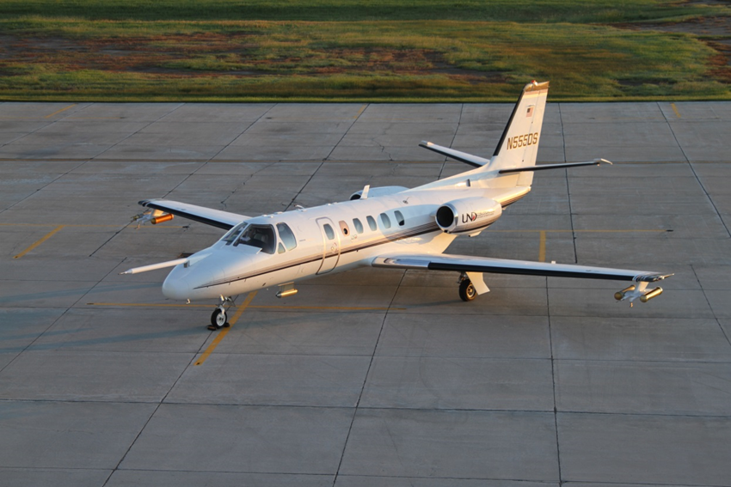
Cessna Citation Aircraft
NASA OLYMPEX Project

Slide 2
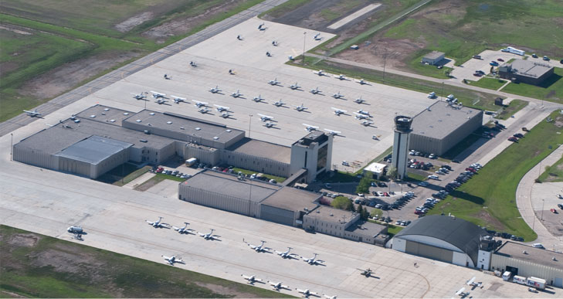
Staging: Pre-mission
Home Base
University of North Dakota Flight Operations
Grand Forks International Airport
Integration
Instrument installation
FAA approval
Test Flights

Slide 3

Staging: OLYMPEX Base Airport
Airport Options:
KPAE: Paine Field
(Snohomish County Airport)
KBFI: Boeing Field (Seattle)

Slide 4
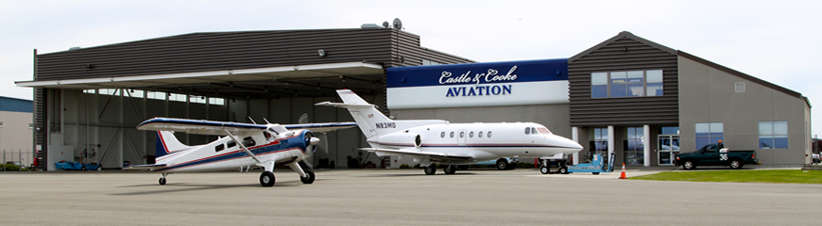
Staging: OLYMPEX Base Airport
Paine Field

Slide 5
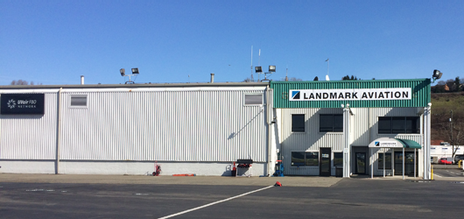
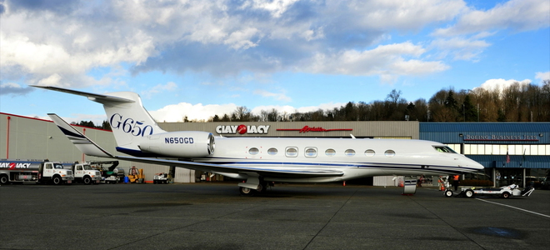
Staging: OLYMPEX Base Airport
Boeing Field

Slide 6
Staging: OLYMPEX Base Airport
Boeing Field
Closer to UW ops center
Paine Field
Fewer delays expected for departures and landings

Slide 7
Citation Flight Operations
Pre-launch
ATC coordination
Aircraft pre-flight
Fueling
Time to launch (lead time) ~90 minutes

Slide 8
Citation Flight Operations
Airborne
Total flight time ~ 3-4 hours, depending on mission weather and base airport weather
Communications – Xchat for science ops, VHF for ATC, Sat phone for backup
Aircraft tracking – NASA REVEAL system, TAMDAR (backup)

Slide 9
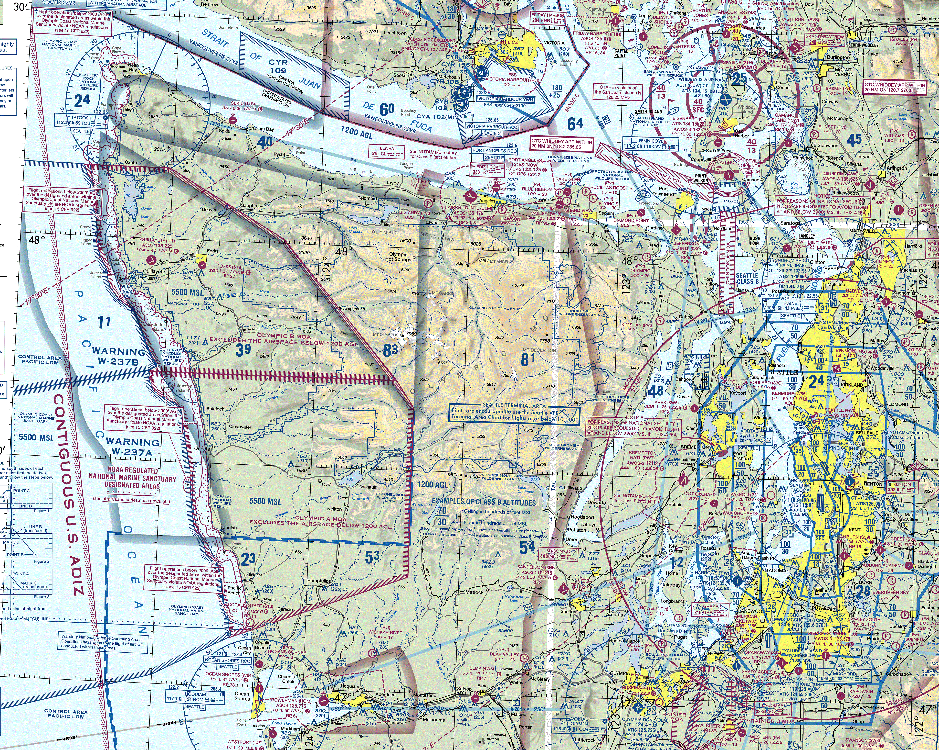
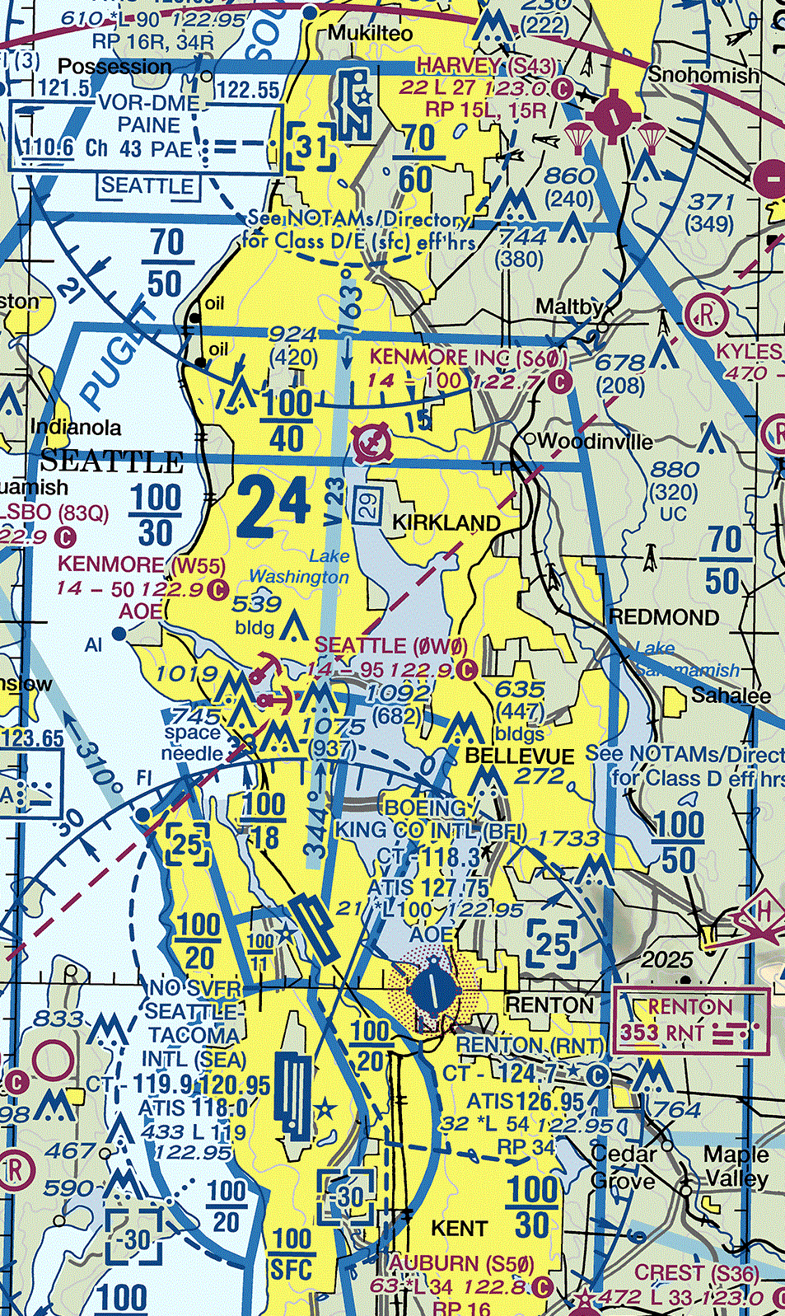
Citation Flight Operations
Airspace Considerations

Slide 10
Citation Flight Operations
Post-flight
Data downloads
Replenish expendables
Begin data processing
Back-to-back missions possible
~ 2 hour turnaround time

Slide 11
Citation Microphysics Instruments
Instrument | Measurement
King | Cloud liquid water
2D-S | Cloud and precipitation particle spectra
HVPS-3 | Precipitation spectra to large sizes
CDP | Cloud Droplet Probe, cloud particle spectra
Nevzorov | Total water content
Rosemount icing probe | Supercooled water
CVI | Total water content

Slide 12
Operational Factors
Mountainous terrain
Minimum safe altitudes
TAWS – Terrain Avoidance Warning System

Slide 13
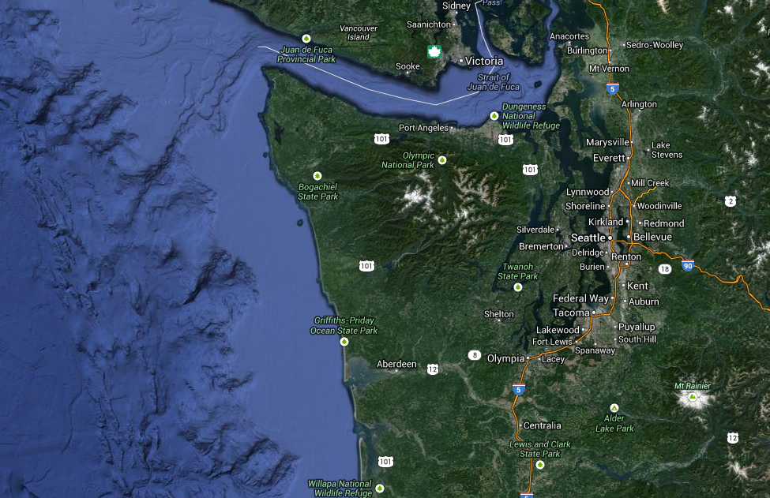
Flight Performance
Citation II
f
MSA 4,000 ft MSL
MSA 5,000 ft MSL
MSA
10,000 ft MSL
500-1000 ft Over Water
Weather Dependent
MSA 2,500 ft MSL
MSA = Min. Safe Altitude for
Instrument Flight Rules
*May operate lower in
Visual Flight Rules

Slide 14

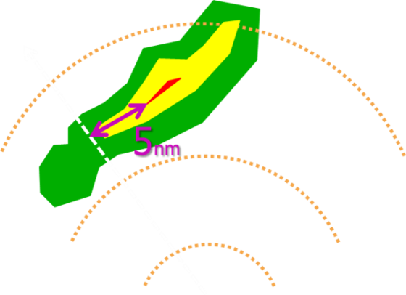
Operational Factors
Flight in the vicinity of convective clouds
  Maximum reflectivity for penetration: 40 dBz
  5 mile separation from >40 dBZ (red display)
Considerations:
  Overall size, altitude
  Larger cell = more clearance
  Lightning avoidance
  Radar bright banding

Slide 15
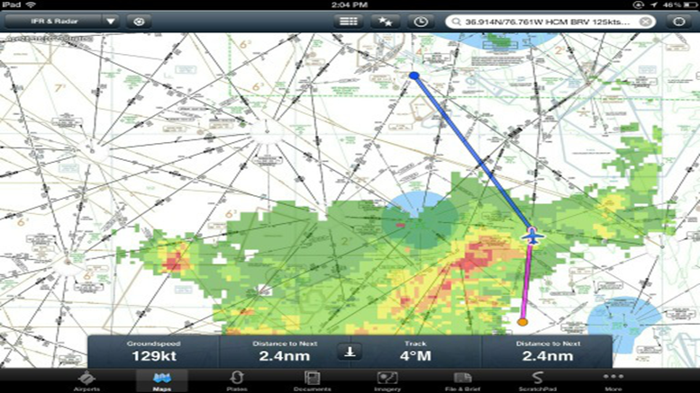
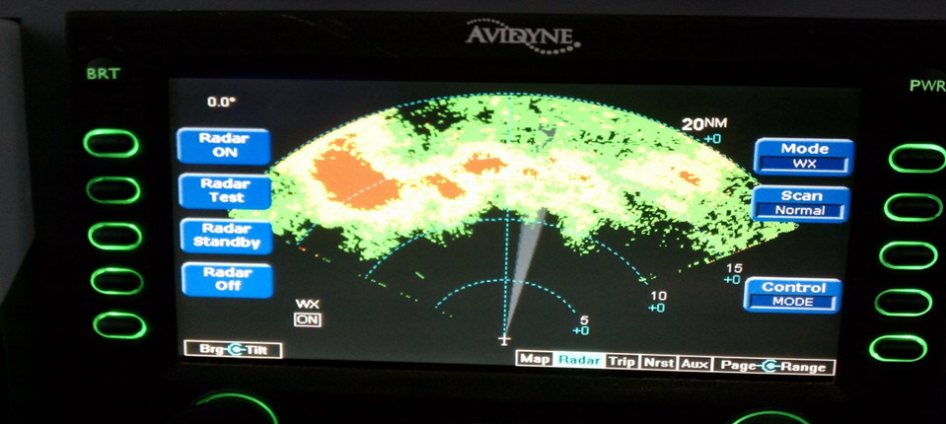
Operational Factors
On board weather radar Uplink NEXRAD radar

Slide 16
Operational Factors
Crew Duty Day:
16 hours preceded by 10 hours rest
14 consecutive days maximum
PIC has final authority, cancel flight at any time if unsafe
MAX limits

Slide 17
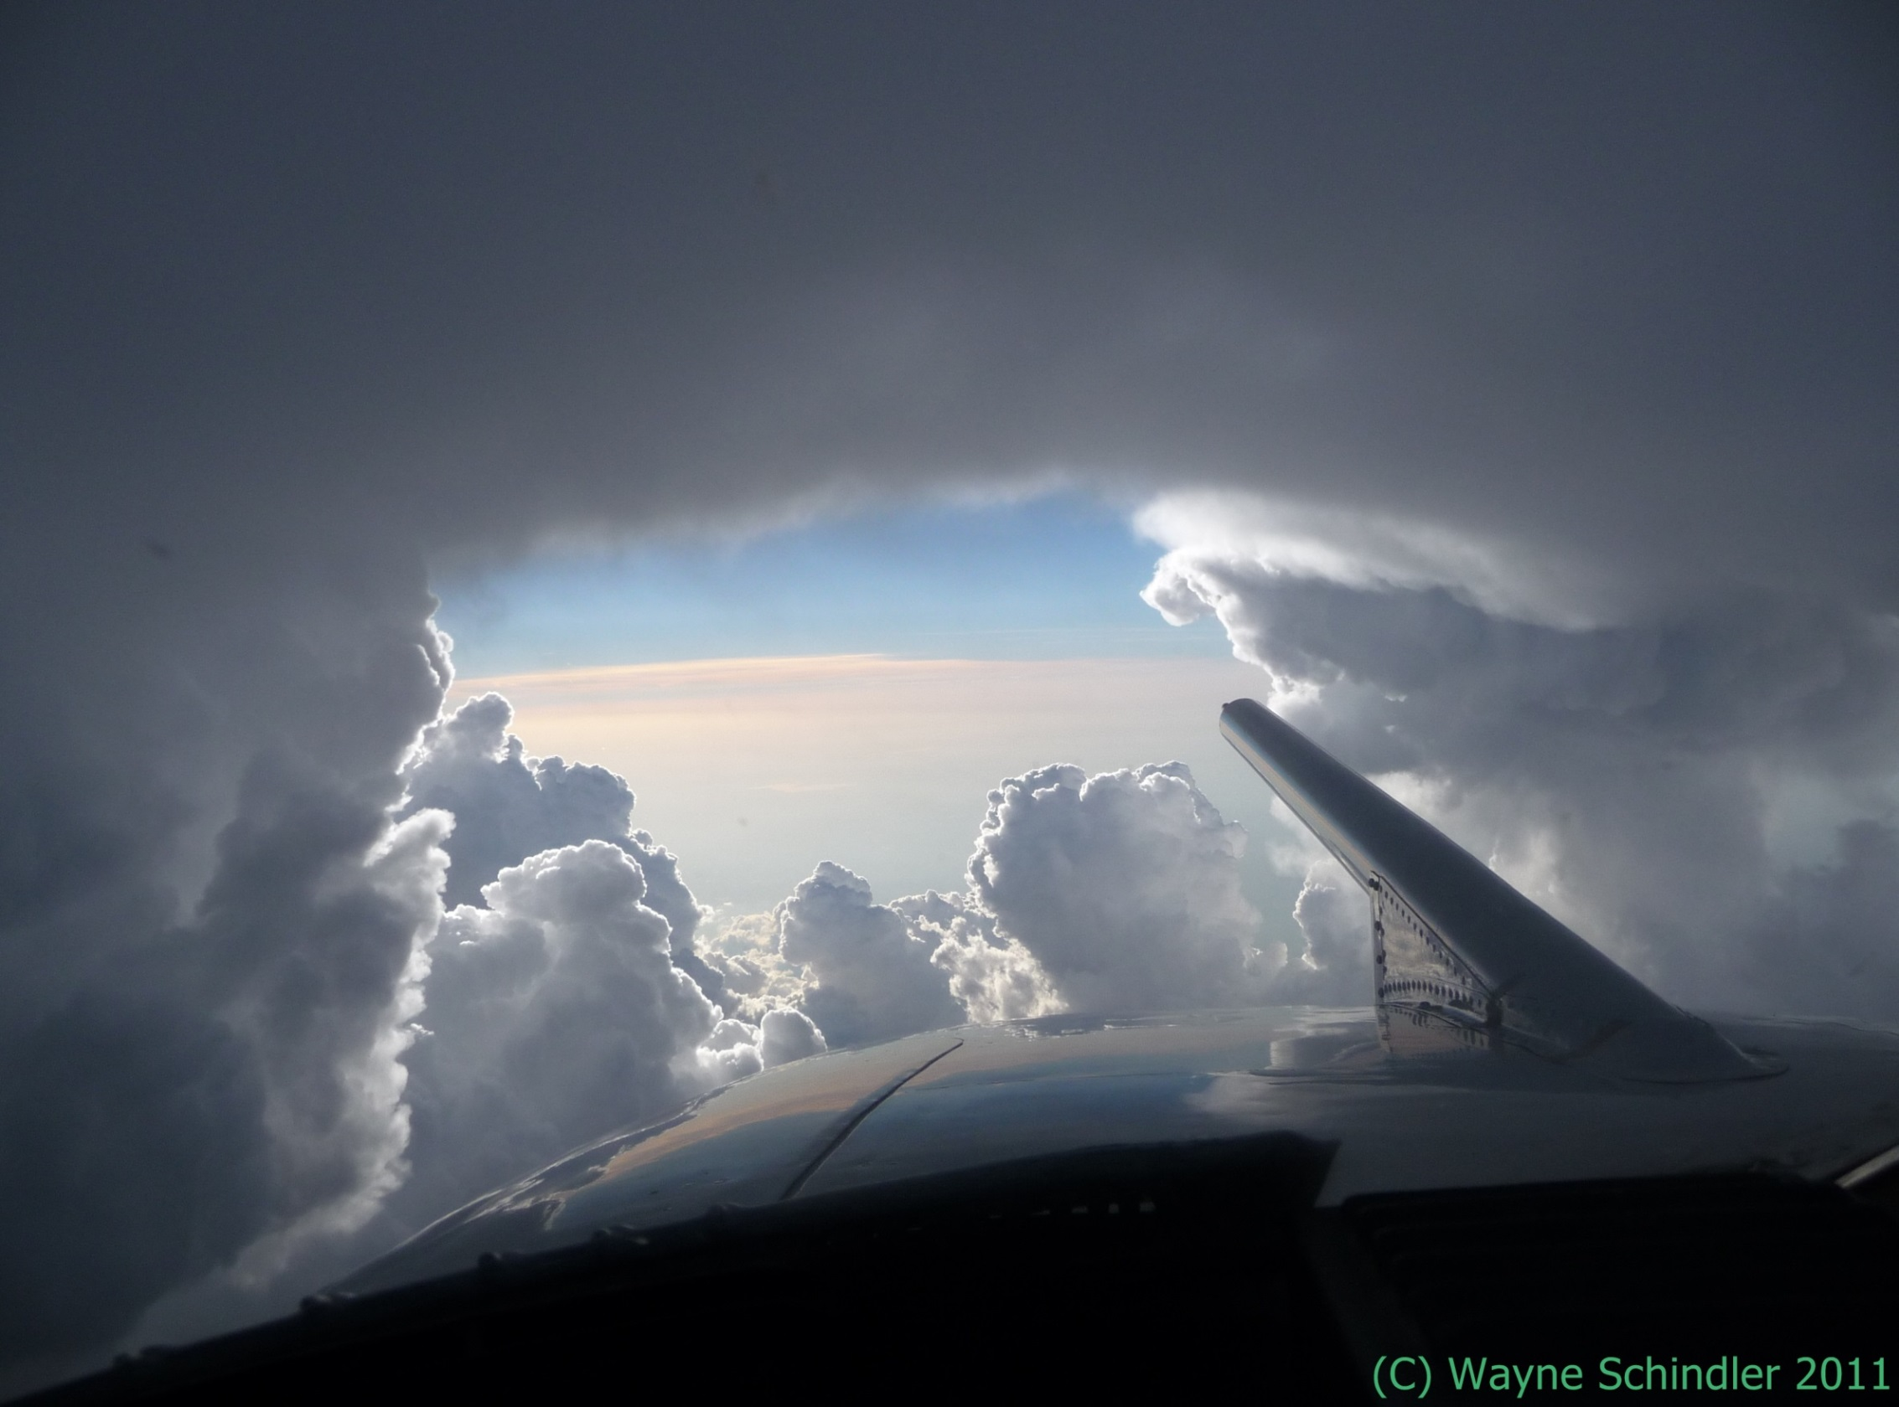
Questions?

